Slide 1
Analysis on Indian Cuisine in New York City

Slide 2
Introduction
New York is the most populous city in the United States with a population of 8,398,748 according to Wikipedia and New York is the most densely populated major city in United States. New York being the popular city all around the world it also known for the great variety of restaurants all over the city. As quoted from google, “First we eat, then we do everything else -M.F.K. Fisher”
The intention is to study the ratings of Indian restaurants all over the city ad to see which cities offer the best Indian cuisine. This analysis can be used to understand the distribution of Indian cultures and cuisines over ‘the most diverse city on the planet — New York City’. Also, it can be utilized by a new food vendor who is willing to open his or her restaurant.

Slide 3

Data Acquisition and Cleaning
New York City Data
https://en.wikipedia.org/wiki/New_York_City
https://en.wikipedia.org/wiki/Demographics_of_New_York_City
Foursquare API
https://developer.foursquare.com

Slide 4
Methodology
In order to segment the neighborhoods of New York City, a dataset is required that contains the boroughs and the neighborhoods, that exist in each borough, with respective latitude and longitude coordinates. This dataset is downloaded using the mentioned URL.
Data is analyzed to understand the structure of the file. A python dictionary is returned by the URL and all the relevant data is found to be in the features key, which is basically a list of the neighborhoods.
The dictionary is transformed, into a pandas dataframe, by looping through the data and filling the dataframe rows one at a time. As a result, a dataframe is created with Borough, Neighborhood, Latitude and Longitude details of the New York City’s neighborhood.
The Foursquare API is used to explore the neighborhoods and segment them.

Slide 5
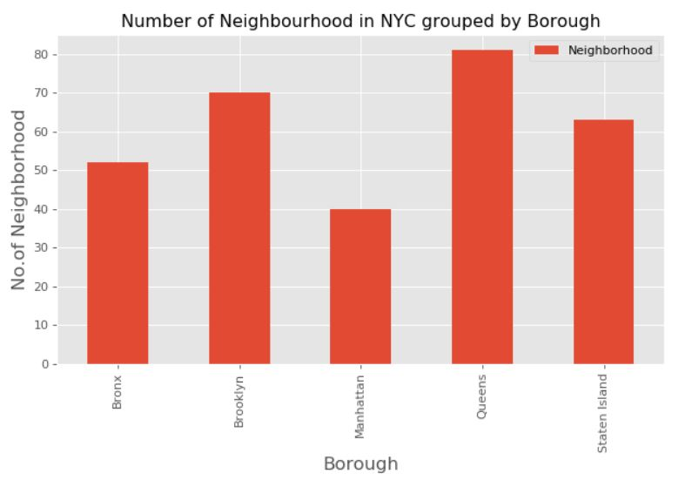
Data Visualization

Slide 6
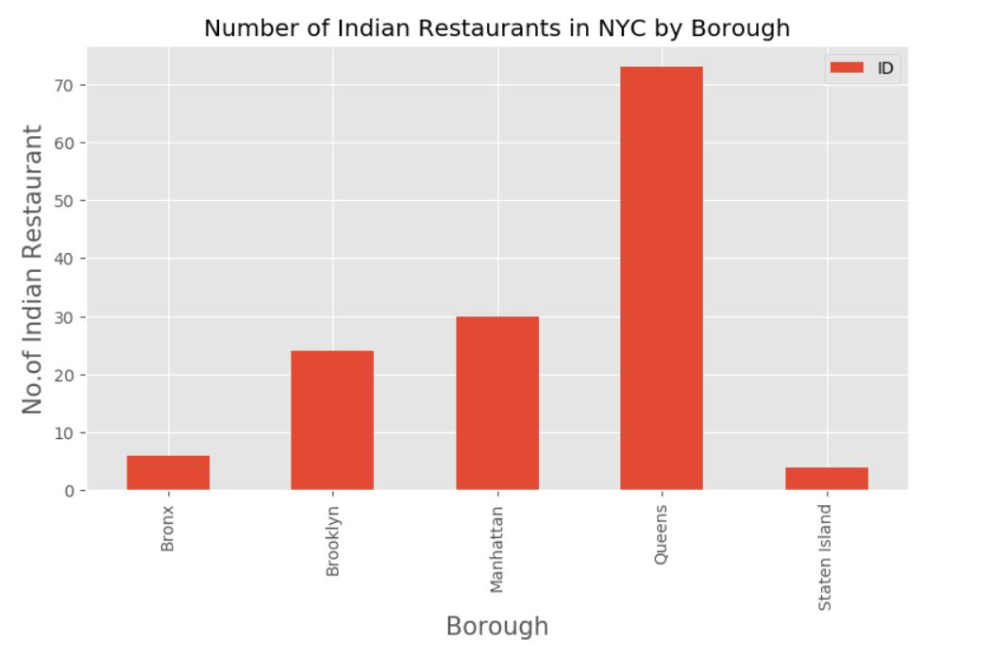
Data Visualization (Cont’d)

Slide 7
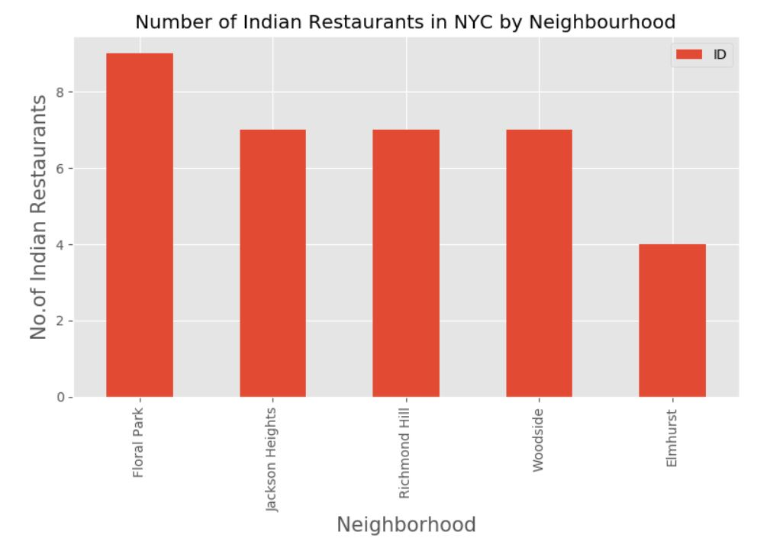
Data Visualization (Cont’d)

Slide 8
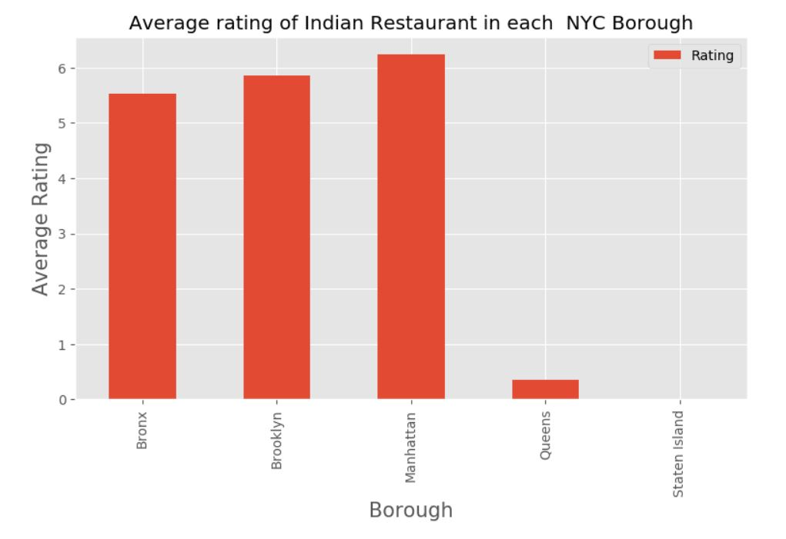
Data Visualization (Cont’d)

Slide 9
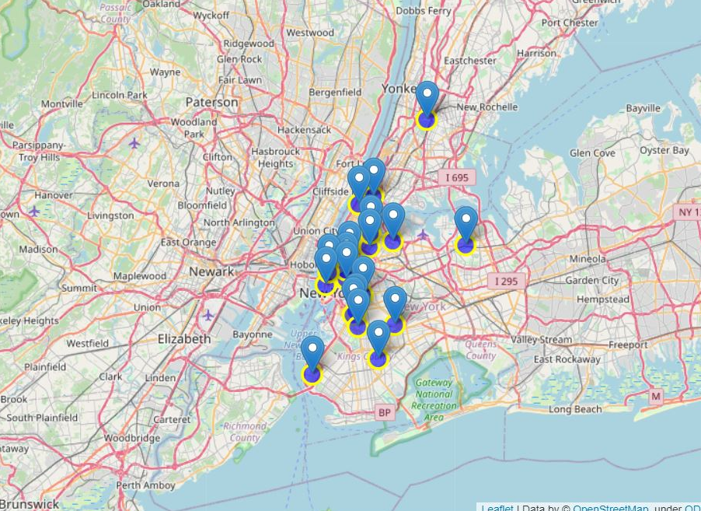
Best neighbourhoods in New York that has highest average rating for Indian Restaurants.
As the result of analyzing New York City Restaurant ratings along with other information the map was intergrated which shows the best neighbourhoods in New York which has the highest average rating for Indian Restaurants.

Slide 10
Thank You!

